Slide 1
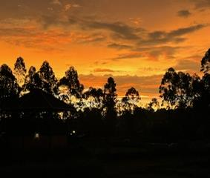
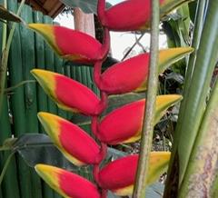
Cordon Uganda Mission Trip Report
1 The. 1:3
November 2023
Notes:
1 The. 1:3: “remembering without ceasing your work of faith, labor of love, and patience of hope in our Lord Jesus Christ in the sight of our God and Father,”
Work of Faith
Labor of Love
Patience (Steadfastness of Hope)
We returned to the Eastern District of Uganda, Mount Elgon region for our second mission trip encompassing three weeks in November 2023.
This was our 4th campaign to Africa and our second to Mount Elgon to work with the church in Bududa village.
We are working there with a local evangelist, Wabomba George, a graduate of the School of Biblical Studies, Jos Nigeria, and John Mark.
From our earlier reports, after our first visit in November 2022, we began to undertake the construction of a church building for assembly, and the work of the Gospel.
Although there are many denominational houses of worship (Catholic & Apostolic), there is not the “presence and influence”…. Standing and recognition that comes with a physical church building in the Bududa area.
In March 2023 we proposed to raise $40,000 over a three-year period (2023-2025) to build a church assembly building. ($20K, $10K, $10K).
The project would be completed in three phases.
2023: Purchase land, clear and lay foundation
2024: Erect building
2025: Complete building (roof, windows, doors, furnishings & landscaping).
The project is on schedule and on budget. Optimistically, ahead of schedule. For 2023:~ $5,000 underfunded.

Slide 2
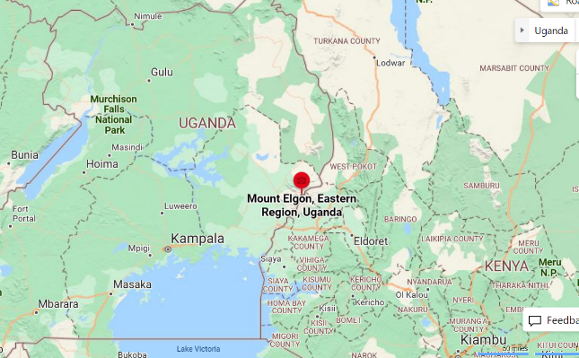
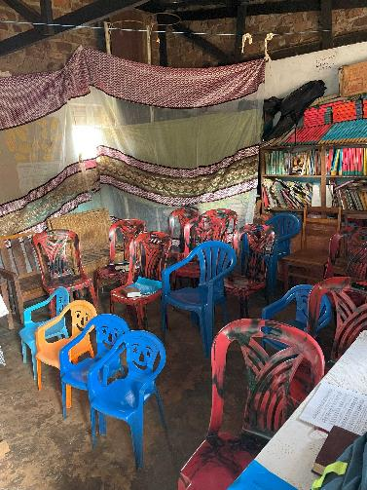
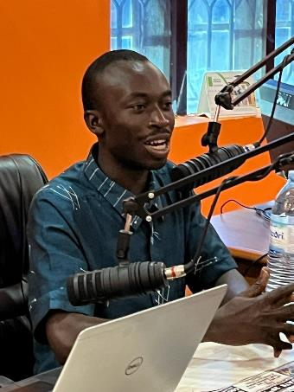
Bududu church at John Mark’s (2022)
WG… fire in them bones!
Notes:
MT Elgon is in the Eastern Province of Uganda near the Kenya border.
Wabomba George is a 2020 graduate of the School of Biblical Studies, Jos Nigeria.
WG conducts a 2x/week “Let the Bible Speak” Radio Broadcast from the main eastern city of Mbale that has a broad outreach. WG & JM receive many call in that allow for follow ups, often from men serving as denominational ministers and pastors.
In 2022 the church of ~ 15 were meeting in a shanty annex affixed to Joh Mark’s house. It fits about 12 people and is inadequate even for the present size, and definitely not conducive to growth and influence.
The church has grown to ~ 30 people and is presently meeting in a rented space in a local schoolhouse.

Slide 3
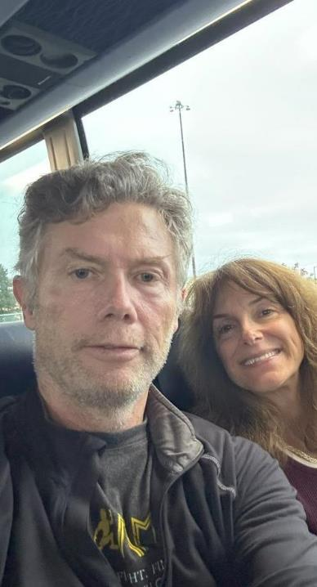
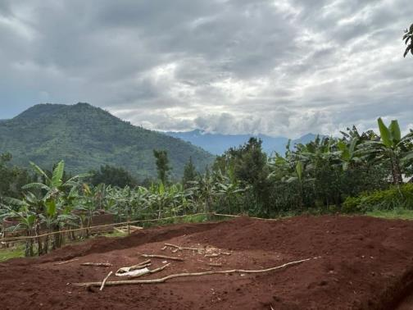
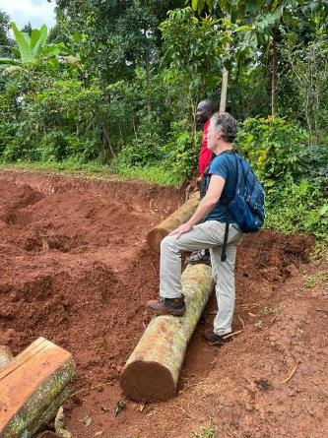
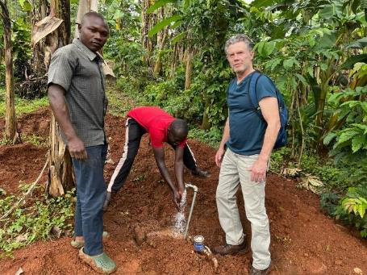
And we’re off!
Eyes on the
church plot
Notes:
2023 Campaign Objectives (1 The. 1:3): Work of Faith, Labor of Love, Steadfastness of Hope
Church Building Project
Survey plot, meet with builder, procure building materials (rock, sand, cement, bricks, block, etc.) to commence Phase 2
Assure budget and costing
Conduct activities which would support the current evangelism efforts in Eastern Uganda
Engage in Let the Bible Speak radio ministry
Conduct follow up bible studies with “Back to the Bible” evangelism series
Conduct local Gospel meetings with church assemblies to teach Sound Doctrine/Sound Words
Support an open Preacher’s Workshop to teach and promote unity of faith
Concord Bus shuttle down to Boston Logan Airport.
Boston redeye to Amsterdam - Amsterdam to Entebbe Uganda via Kigali Rwanda
I look tired already and Marci is raring to go!

Slide 4
Notes:
1 Cor 3:11: “For no other foundation can anyone lay than that which is laid, which is Jesus Christ.”
There is work to do…on every hand…(2)

Slide 5
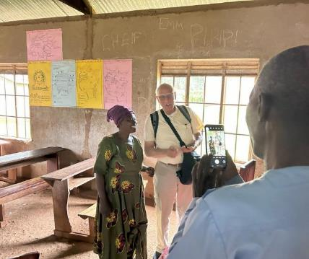
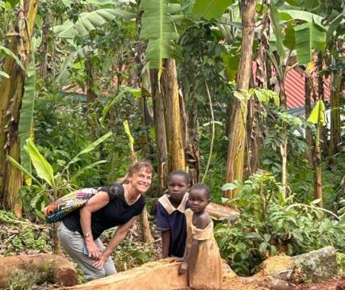
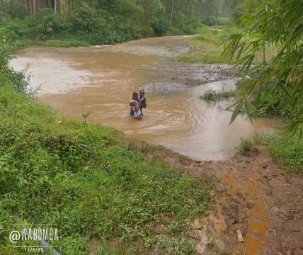
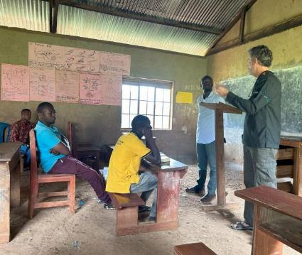
Bududa church of Christ
Notes:
Act 2:47: “praising God and having favor with all the people. And the Lord added to the church daily those who were being saved.”
Meeting with the local congregation. The Lord is active and working in eastern Uganda. The church has experienced growth since we were there a year ago and is meeting in a rented room in a local schoolhouse.
The assembly with the congregation in Bududa centered around the theme of “What would Paul say to encourage the church, here in Eastern Uganda?”
Is it any different for us, in our time now, than for the struggles of faith of our forefathers?
Why not look to the bible for a biblical answer to a timeless spiritual dilemma!
Among the earliest of New Testament writings are Paul’s Letters to the church at Thessalonica, written very soon after Paul’s initial visit during his 2nd missionary journey (Acts 16 & 17, c. 50-52 AD).
What did Paul commend and what encouragement did he offer to this fledging church plant? (c.f. 1 The. 1:3 & Phi. 4:3)
True Yokefellows in our work of faith (Jam. 1:22-24; 2:17-26)
True Yokefellows in our labor of love (Mat. 28:19-20; Mark 16:15; Acts 4:12, 20; Rom. 13:9-10)
True Yokefellows in our steadfastness of hope (Luke 9:51, 62; Gal. 6:9, 1 Cor. 15:58, Col. 1:23; Heb. 3:14; 2 Pet. 3:17)

Slide 6
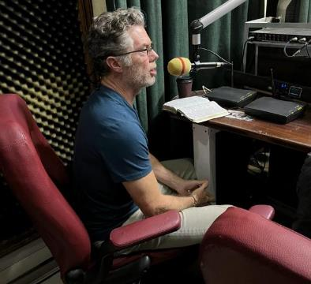
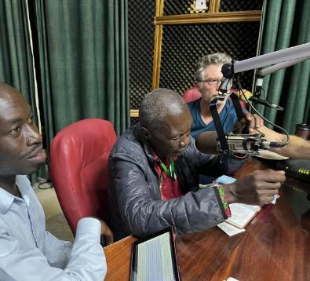
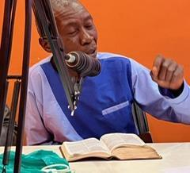
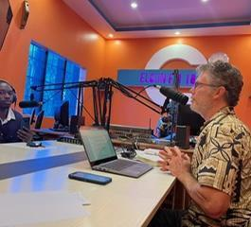
https://www.facebook.com/wabomba.george.9
Let the Bible Speak Radio Ministry
Notes:
The major outreach is via the 2x weekly radio broadcast. Please visit Wabomba George’s FB page (link provided).
Link to WG FB page: https://www.facebook.com/wabomba.george.9
The Radio Ministry is supported by brother Scott Richards, pictured on the previous slide. We had the great blessing to meet up with Scott in Bududa for a short time. Scott Richards works with the Tara church of Christ in Crossville, TN. Scott’s impact extends throughout Asia and Africa in many fields. His support and work with WG and JM & the Bududa church has been key and essential to the growth of the Lord’s church in Eastern Uganda.
Isa 55:11 So shall my word be that goeth forth out of my mouth: it shall not return unto me void, but it shall accomplish that which I please, and it shall prosper in the thing whereto I sent it.

Slide 7
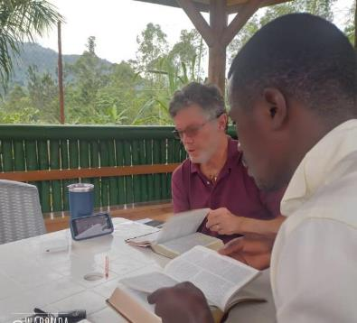
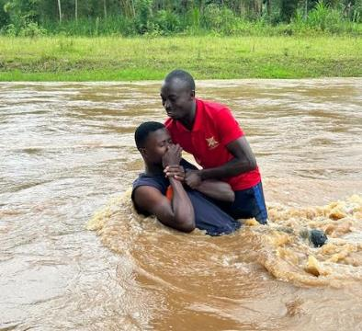
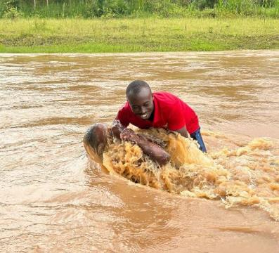
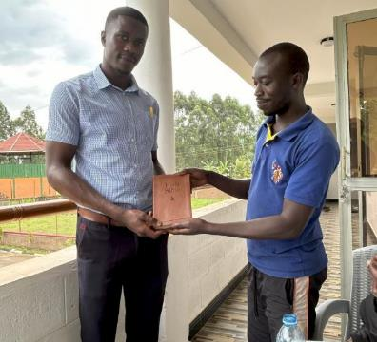
BTTB LINKS
Back to the Bible | WVBS Online Video
Personal Evangelism Seminars | House to House Heart to Heart
Back to the Bible (BTTB) | Glad Tidings Publishing
Back to the Bible Studies
Notes:
This is Edrine Mubajje, he is the Operations Officer at the Hotel we were staying at. He was fascinated with the concept of TRUTH as developed in Rob Whitacres’s Back to the Bible Evangelism series.
Because of BTTB simplicity (clarity and progression), we used it inclusively in our one-on-one follow up bible studies.
Here are some of Rob Whitacre’s wonderful resource links to His/HTH Evangelism Training
Back to the Bible (BTTB) | Glad Tidings Publishing
Personal Evangelism Seminars | House to House Heart to Heart
Back to the Bible | WVBS Online Video
“These things can be understood”
Edrine was thrilled to receive a new copy of the Apologetics Press study bible.

Slide 8
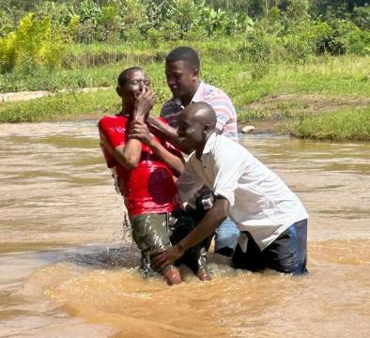
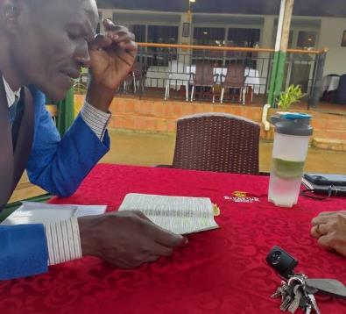
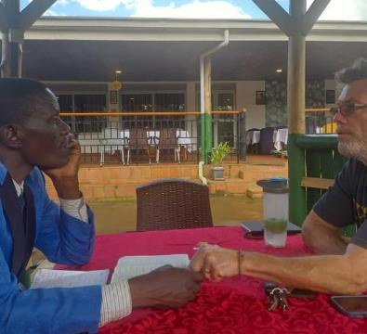
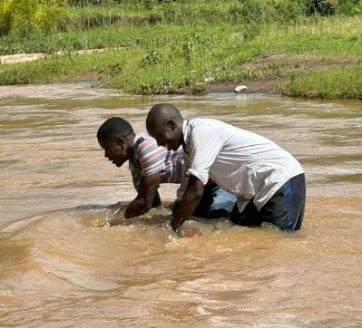
2 Cor 5:17: Therefore, if anyone is in Christ, he is a new creation; old things have passed away; behold, all things have become new.
BTTB: Moses
Notes:
Moses was a life long Pentecostal Pastor in the capital city of Kampala. He had heard the radio broadcast and called in requesting to meet with us.
We quickly encouraged Moses and invited him to attend the Preacher’s Workshop which he was excited to do.
Teach, Baptize, teach… that’s Edrine, baptized just a few days earlier with Wabomba George.
Moses committed himself to the Lord and desires to return to his home state in Eastern Uganda and plant a new congregation.

Slide 9
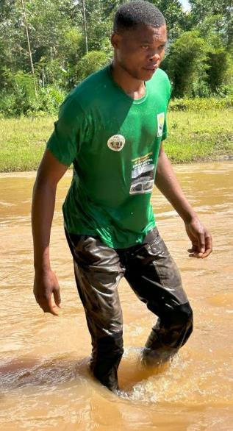
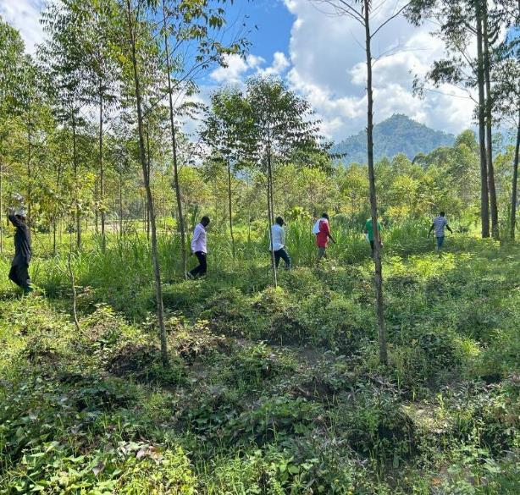
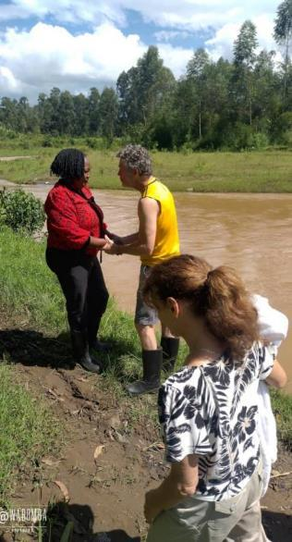
Notes:
What a glorious day this was as we walked down to the river behind the hotel.
Andrew: Gate guard and security, “I want to be saved”
Christine: the hotel General Manager, who kept repeating, “Evidence-Facts-Truth-Faith”

Slide 10
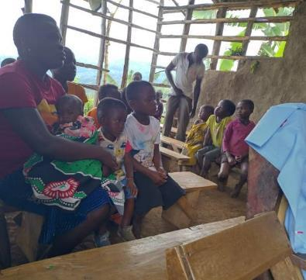
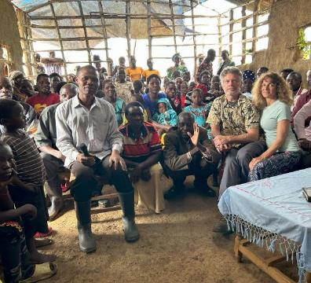
Gospel Meetings : There is no other Name
Acts 4:12
Notes:
We conducted two Gospel Meetings providing day long instruction on the One Church of our Lord Jesus Christ
Here, a young woman with child responds to the Gospel call.
Acts 4:12, 1 Cor. 1:10, Eph. 4:4-6, 1 Cor. 3:10…. Church unity was a resonant theme throughout.

Slide 11
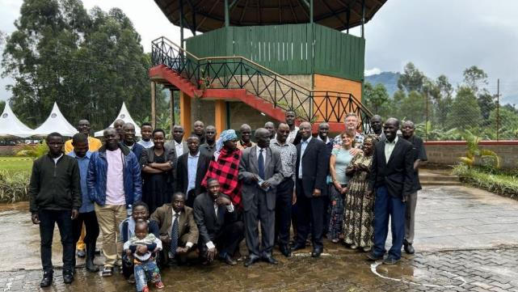
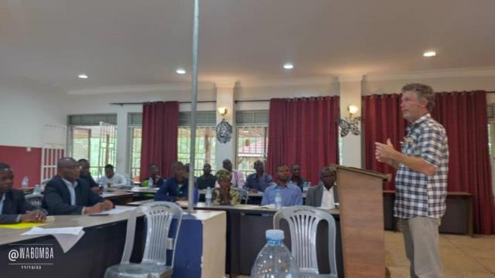
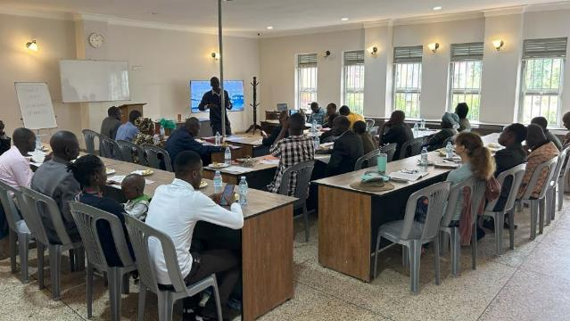
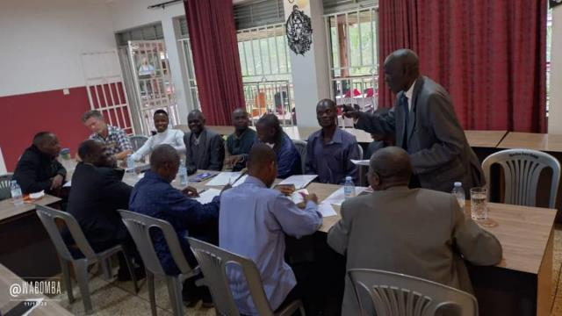
Preacher’s Workshop
Notes:
The Preacher’s Workshop was the culmination of our faith building objectives for this trip. It was open and well attended. We had 31 in attendance, including 5 women. The men who attended were preachers & evangelists from within the Lord’s church and also of various denominational backgrounds.
The theme of the Workshop was “Shining the Light of the Glorious Gospel in Eastern Uganda” : “True Yokefellows in the Faith” (Phi. 4:3)
The objectives:
Promote and encourage one another: Strength & Unity Together (“we are not alone”)
Foster networking: communication, collaboration, cooperation, coordination… leverage one another’s efforts:
FORCE MULTIPLICATION: the whole is greater than the sum of the individual members
Presentations to develop objectives & support theme:
Unity of Faith: We are True Yokefellows through Sound Words & Sound Doctrine (Acts. 2:42; 2 Tim. 1:13)
Unity in the Sound Doctrine (1 Cor. 1:10)
Unity in service (1 Tim. 4:6, 16; 2 Tim. 4:5)
Unity in discipleship (Gal. 1:6-10)
Paul’s Letter to the churches of Eastern Uganda (1 The. 1)
True Yokefellows in our work of faith (Jam. 1:22-24; 2:17-26)
True Yokefellows in our labor of love (Mat. 28:19-20; Mark 16:15; Acts 4:12, 20; Rom. 13:9-10)
True Yokefellows in our steadfastness of hope (Luke 9:51, 62; Gal. 6:9, 1 Cor. 15:58, Col. 1:23; Heb. 3:14; 2 Pet. 3:17)
Men’s and Women’s Breakout Sessions to discuss and develop action items for building and edifying each other in our common faith.

Slide 12
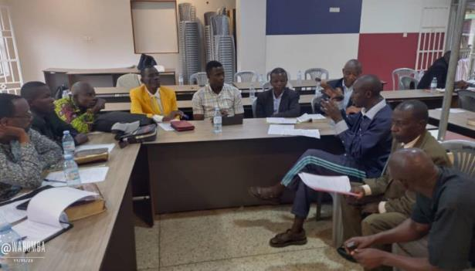
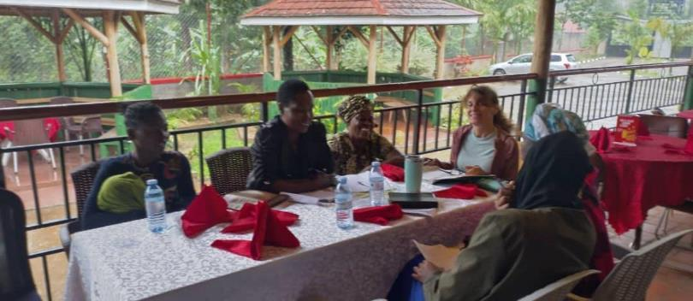
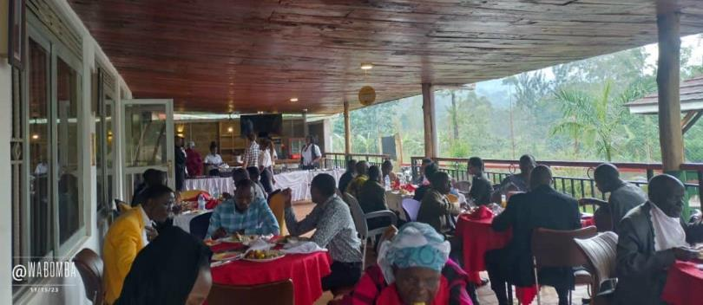
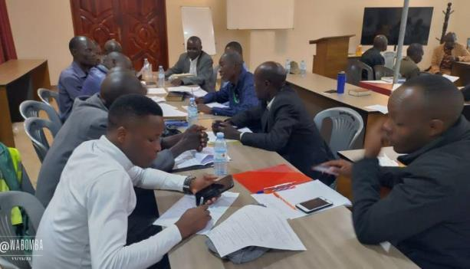
Notes:
Break out groups and networking
The workshop was well attended
Preachers, “pastors”, ministers from around Eastern Uganda District, and as far away as the capital city of Kampala as well as one brother from Kenya.

Slide 13
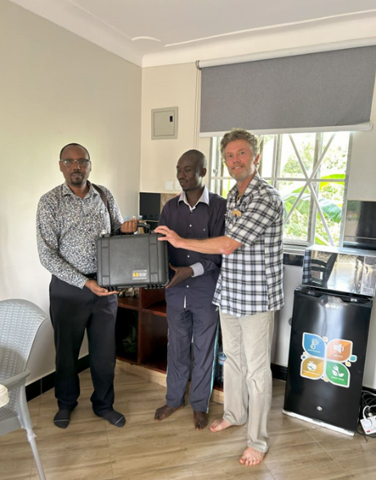
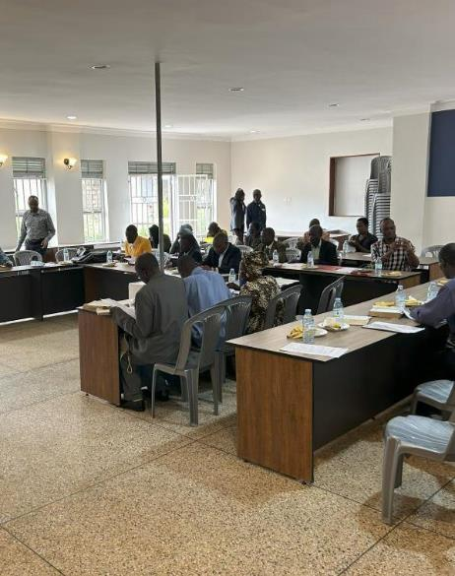
Notes:
We continued our partnership with World Video Bible School and delivered a 12th Evangelism Kit to brother Sam in Kenya.
We hope to visit brother Sam in 2024 and support him in hosting a Gospel meeting and a Preacher’s Workshop

Slide 14
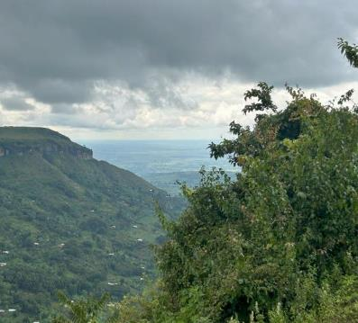
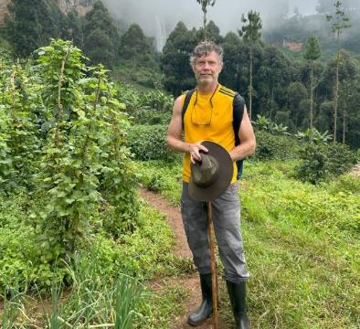
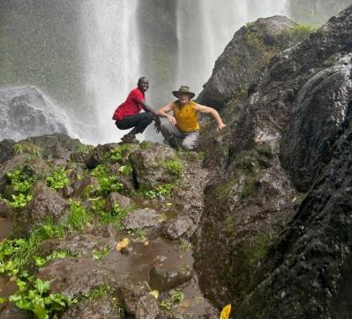
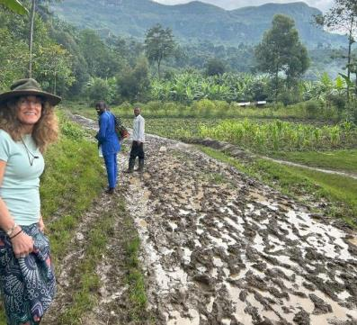
With thanks for your continued love and partnership
2 Cor. 9:8
Notes:
“And God is able to make all grace abound toward you, that you, always having all sufficiency in all things, may have an abundance for every good work.” (2 Cor. 9:8)

